Slide 1
XAI-Guided Interventional Retraining for Domain Adaptation Progress Report
QIU Yaowen, yqiuau @ connect.ust.hk

Slide 2
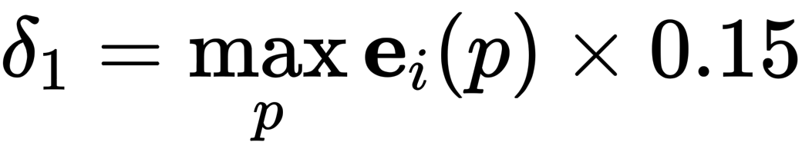
Version 1: Completely follow original idea
Compute New Training Set:
Use Perplexity to filter pure examples
Define the C-perplexity percentile = 20% as threshold
Define the X-perplexity threshold = 0.3
No Union Training, only used examples from (1)
Generate examples with no background using Gradcam and

Slide 3
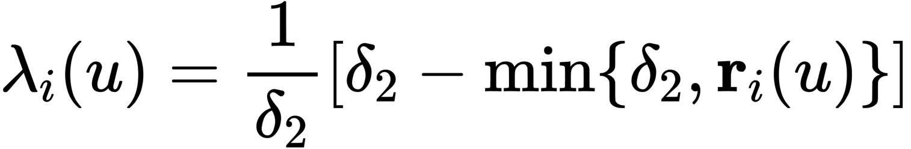
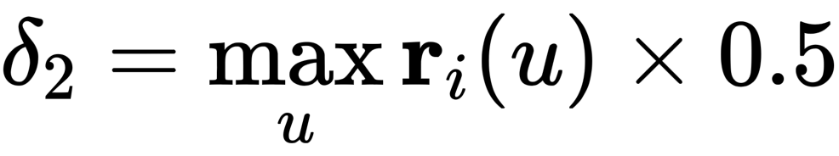
Version 1: Completely follow original idea
Training Setting:
EPOCHS = 10
LEARNING RATE = 1e-5, ADAM

Slide 4
Version 1: Completely follow original idea
Model | Val Top-1 Acc | Val Top-5 Acc | V2 Top-1 Acc | V2 Top-5 Acc | Top-1 Gap | Top-5 Gap
ResNet50 | 75.67% | 92.44% | 63.01% | 84.14% | 12.66% | 8.30%
ResNet50 (v1) | 74.89% (-0.78%) | 91.57% (-0.87%) | 62.55% (-0.46%) | 84.01% (-0.13%) | 12.34% (-0.32%) | 7.56% (-0.74%)
Both Accuracy on validation set and imagenetv2 drops
The Accuracy gap decreases.
Observed that bias distribution of v1 is very different from baseline’s（forget to save fig).

Slide 5
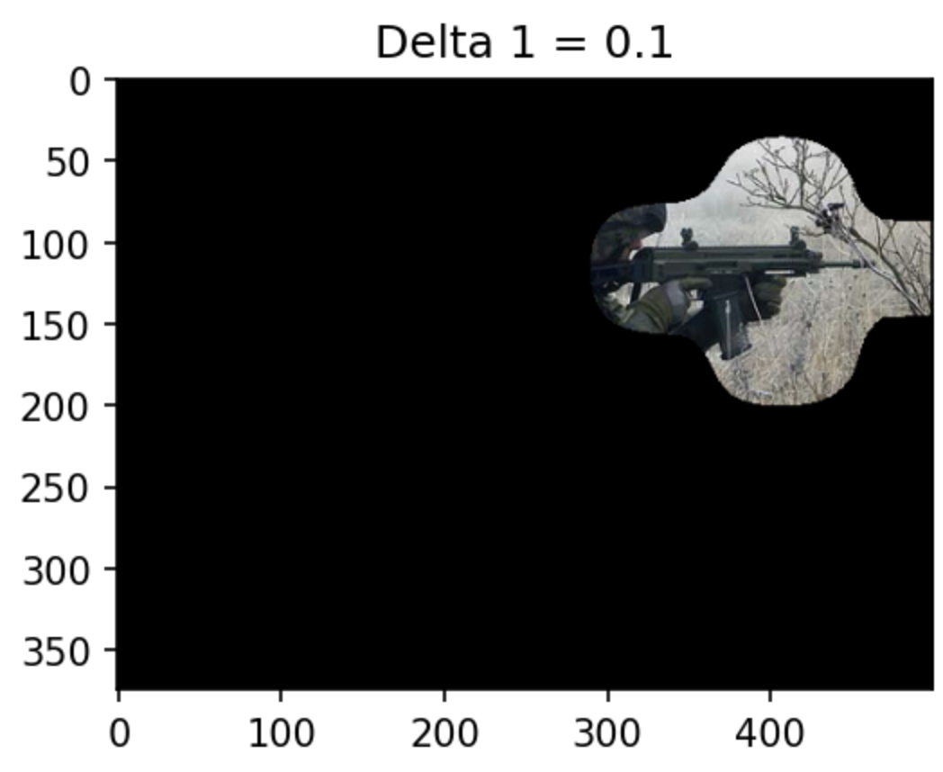
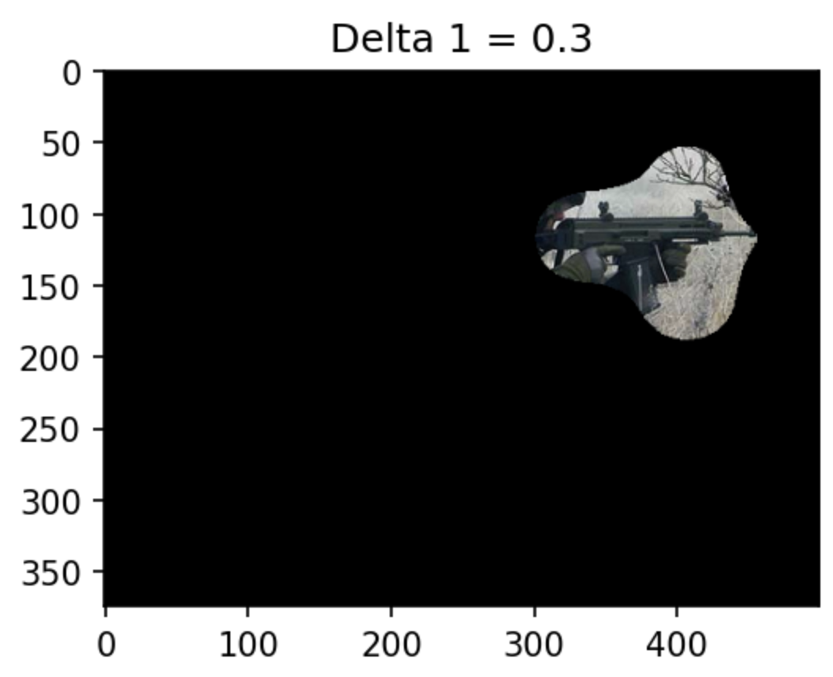
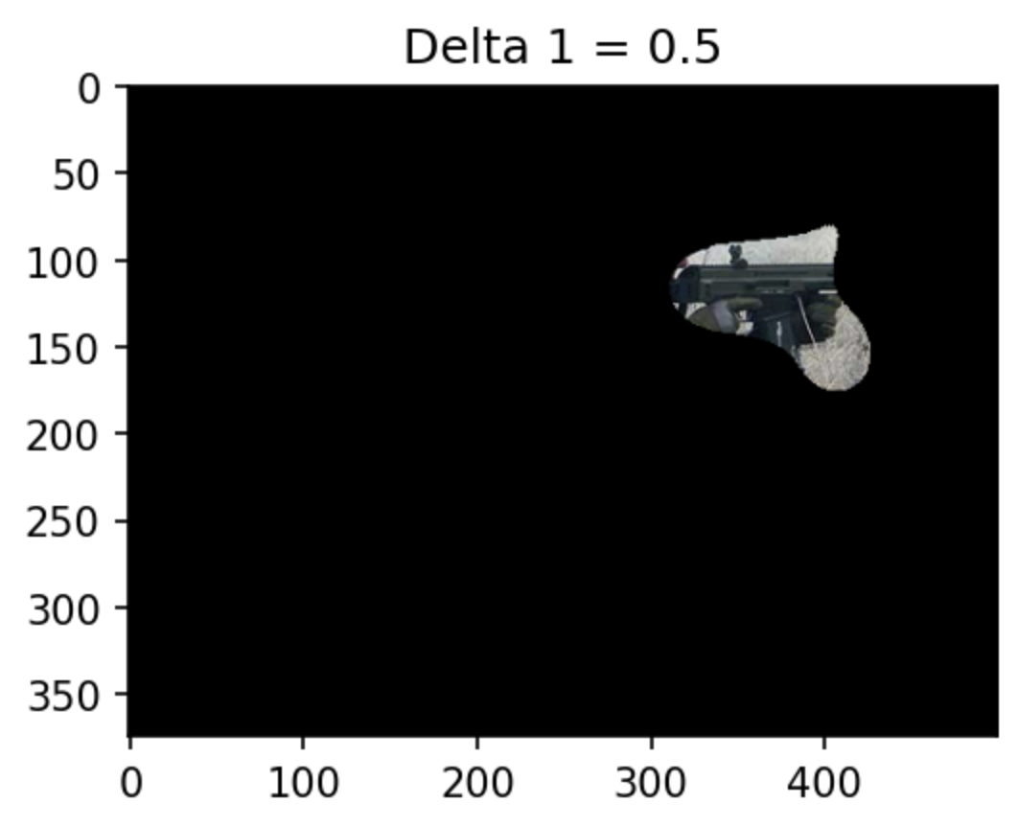
Version 1: Problems
Small delta1 fails to locate the ground truth object precisely.
Apply filter to the whole training set leads to unbalance distribution among labels
The distribution of bias changed a lot, which is not ideal

Slide 6
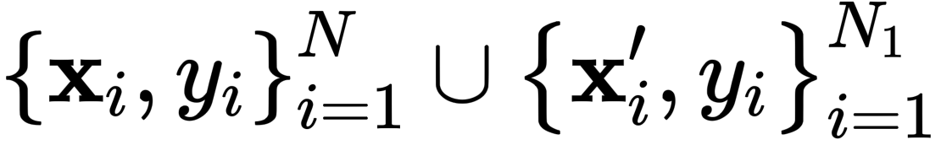
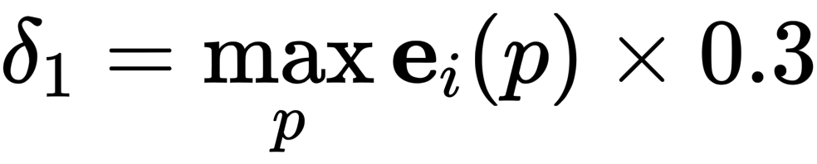
Version 2: Fix some problems based on v1
Compute New Training Set:
Use C-Perplexity only to filter pure examples for each class
Define the C-perplexity percentile = 20% as threshold
Maintain Class balance
Union Training, x_newtrain =
Generate examples with no background using Gradcam and

Slide 7
Version 2: Fix some problems based on v1
Training Setting:
EPOCHS = 10
LEARNING RATE = 1e-6, ADAM
Adopt weight decay on W & b
No intervention to change feature values

Slide 8
Version 2: Fix some problems based on v1
Model | Val Top-1 Acc | Val Top-5 Acc | V2 Top-1 Acc | V2 Top-5 Acc | Top-1 Gap | Top-5 Gap
ResNet50 | 75.67% | 92.44% | 63.01% | 84.14% | 12.66% | 8.30%
ResNet50 (v1) | 74.89% (-0.78%) | 91.57% (-0.87%) | 62.55% (-0.46%) | 84.01% (-0.13%) | 12.34% (-0.32%) | 7.56% (-0.74%)
ResNet50 (v2) | 75.76% (+0.11%) | 92.59% (+0.13%) | 62.98% (-0.03%) | 84.13% (-0.01%) | 12.78% (+0.12%) | 8.46% (+0.16%)
Accuracy on validation set and imagenet-v2 are significantly better than v1
But the gap is even worse than baseline
The distribution of v1’s weight & bias become similar to baseline’s

Slide 9
A finding: baseline model train on full Imagenet
Let the baseline model train on full ImageNet for some epochs using same parameters
Keep Track on its performance on validation set and imagenetv2
Here the baseline used in Inceptionv3
Advice proposed by Gao Han
Acc on validation set & Imagenetv2 increases, gap increases (not shown)
The performance of XGIR will be affected by this.
Epoch | Top-1 acc | Top-5 acc
0 | 77.90% | 93.70%
1 | 77.79% | 93.99%
2 | 77.90% | 94.09%
3 | 78.06% | 94.12%
4 | 78.12% | 94.15%
5 | 78.15% | 94.10%

Slide 10
Version 3: Adopt different baseline based on v2
Baseline Model : Inceptionv3
It is hoped that it can generate more reliable Gradcam
1. Use this baseline model to adopt version 2 XGIR
2. Train the baseline model using full ImageNet for 5 epochs, then adopt version 2 XGIR

Slide 11
Version 3: Adopt different baseline based on v2
Model | Val Top-1 Acc | Val Top-5 Acc | V2 Top-1 Acc | V2 Top-5 Acc | Top-1 Gap | Top-5 Gap
ResNet50 | 75.67% | 92.44% | 63.01% | 84.14% | 12.66% | 8.30%
ResNet50 (v1) | 74.89% (-0.78%) | 91.57% (-0.87%) | 62.55% (-0.46%) | 84.01% (-0.13%) | 12.34% (-0.32%) | 7.56% (-0.74%)
ResNet50 (v2) | 75.76% (+0.11%) | 92.59% (+0.13%) | 62.98% (-0.03%) | 84.13% (-0.01%) | 12.78% (+0.12%) | 8.46% (+0.16%)
Training on Full ImageNet will increase accuracy on both the validation sets, and increases gap.
It looks like that current XGIR tends to increase the accuracy on validation set only, but not Imagenetv2.
And instead larger the gap.
Model | Val Top-1 Acc | Val Top-5 Acc | V2 Top-1 Acc | V2 Top-5 Acc | Top-1 Gap | Top-5 Gap
Inceptionv3 | 77.90% | 93.70% | 63.87% | 85.17% | 14.03% | 8.53%
Inceptionv3-epoch 5 | 78.15% (+0.25%) | 94.10% (+0.40%) | 63.90% (+0.03%) | 85.19% (+0.02%) | 14.25% (+0.22%) | 8.91% (+0.38%)
Inceptionv3 (v2) | 78.10% (+0.20%) | 93.98% (+0.28%) | 63.79% (-0.08%) | 85.12% (-0.05%) | 14.31% (+0.28%) | 8.86% (+0.33%)
Inceptionv3-epoch 5 (v3) | 78.19% （+0.29%） | 94.13% （+0.43%） | 63.87% （+0.00%） | 85.18% （+0.01%） | 14.32% （+0.29%） | 8.92% （+0.39%）

Slide 12
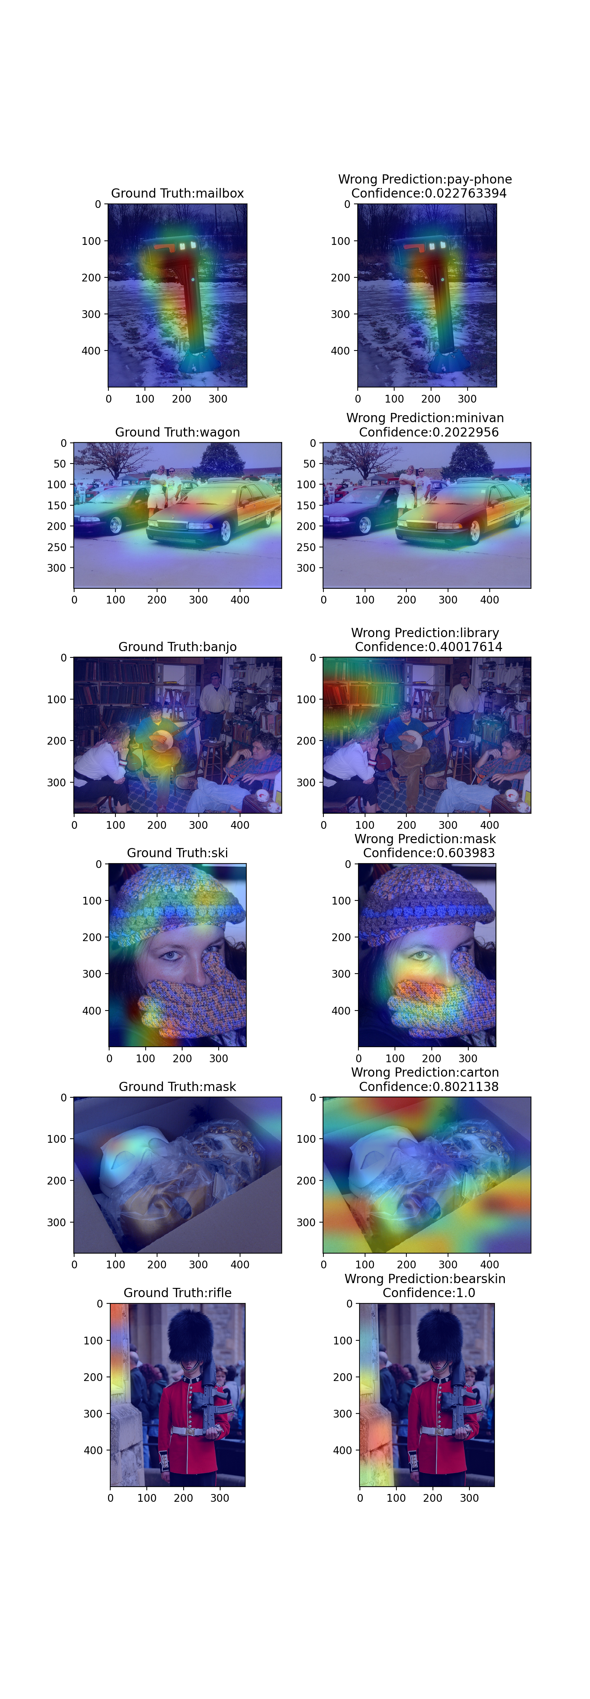
Analysis on Wrong Prediction

Slide 13
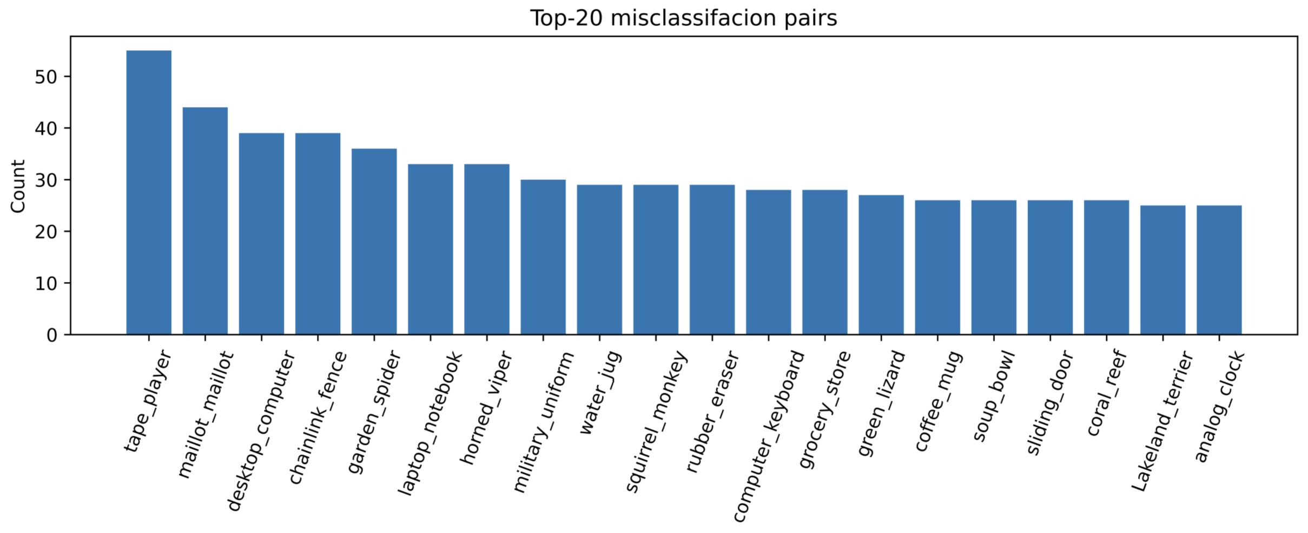
Analysis on Wrong Prediction
Most of wrong prediction are not caused by class co-occurrence,
But class-occurrence is an important reason of wrong prediction

Slide 14
Definition of types of error
- Type I Error, True GroundTruth Attention, Wrong Prediction Attention (Largest Proportion, at least 40% ~ 50%)
- Type II Error, Wrong GroundTruth Attention, True Prediction Attention (Mislabled issue, Few examples)
- Type III Error, Both GroundTruth Attention and Wrong Prediction Attention are True (Class Co-occurence, Second Largest Proportion, around 10% ~ 20%)
- Type IV Error, Both GroundTruth Attention and Wrong Prediction Attention are Wrong (Impossible to solve, Rare)
We should mainly Focus on Type I & Type III Error

Slide 15
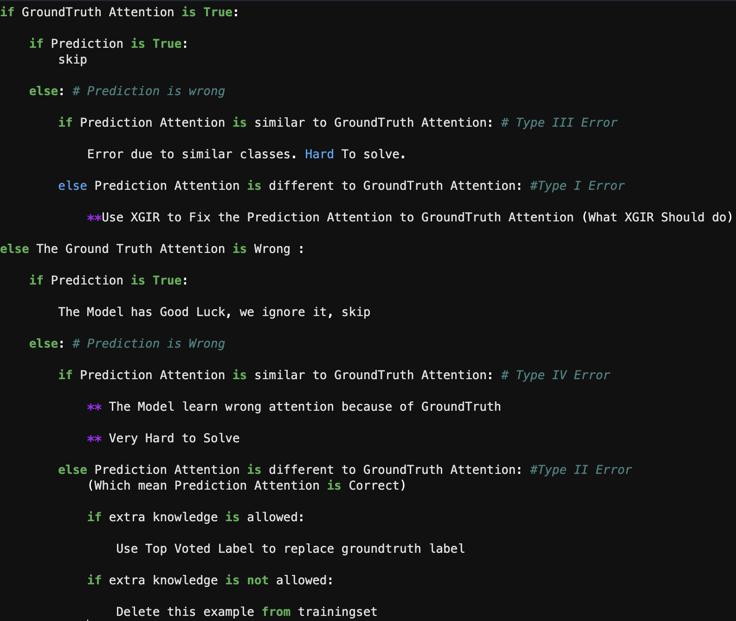
Idea of when to adopt XGIR, based on type of error

Slide 16
Idea of when to adopt XGIR, based on type of error
Problem:
- There is no way to know the True Attention Location in ImageNet Data (Unlike Object Detection Dataset)
- How to measure the difference of the location of GroundTruth Attention and Wrong Prediction Attention?
1. Presume that (As we previously did)
- examples with low C-perplexity always have Correct GroundTruth Attention
- examples with high C-perplexity always have Wrong GroundTruth Attention
2. Introduce some tools to measure the difference

